Slide 1

Construction Update
Weeks 13, 14 and 15
September 4th to 8th, 2017
September 11th to 15th,, 2017
September 18th to 22nd , 2017

Slide 2

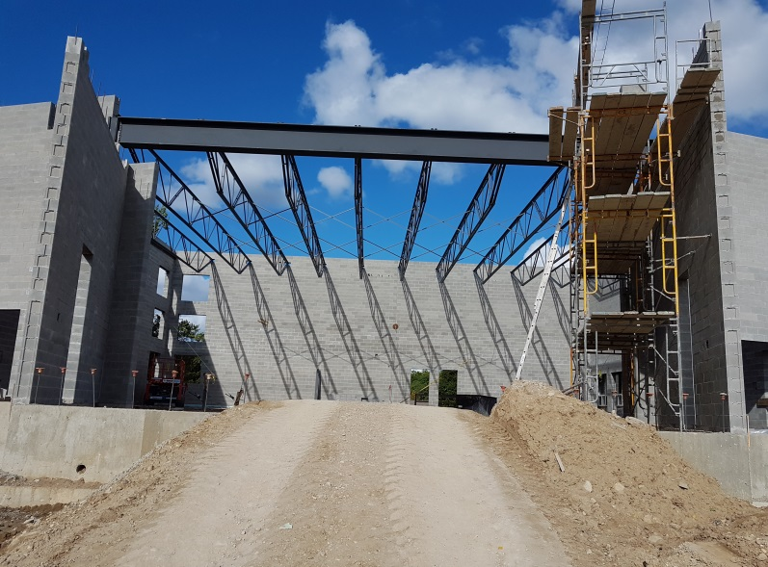
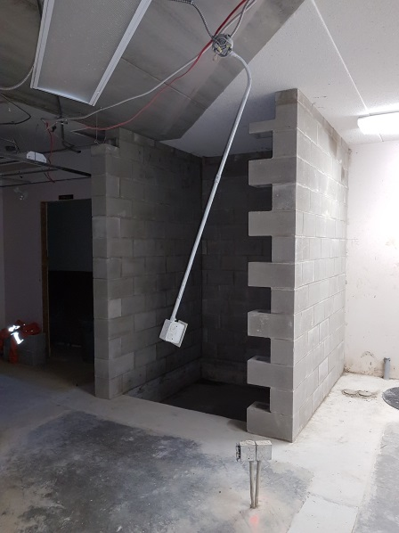
Progress Report Week 13
Steel roof trusses placed over gym (future sanctuary)
Concrete block walls in place in basement for elevator shaft (awaiting steel beam)

Slide 3
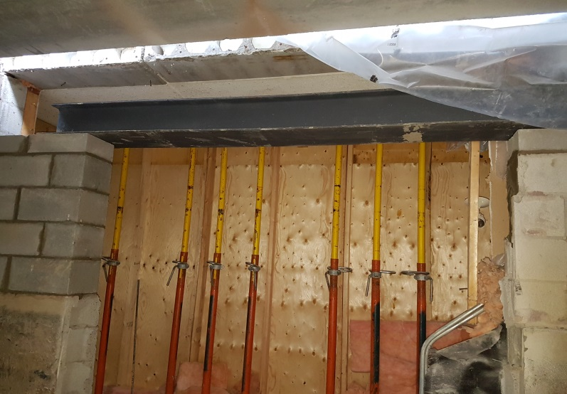
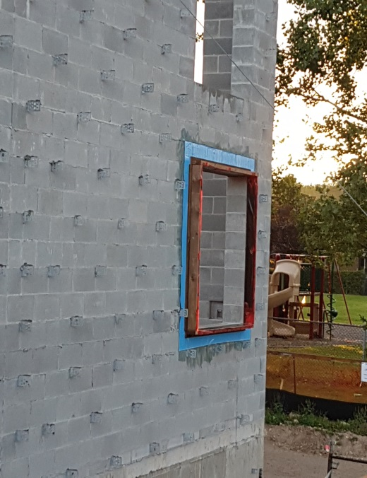
Progress Report Week 13
Steel beam placed to support existing precast slabs at new opening between fellowship room and new storage area. Note shoring in foreground
Rubber membrane and build outs in preparation for foam wall insulation and window in gym (future sanctuary)

Slide 4
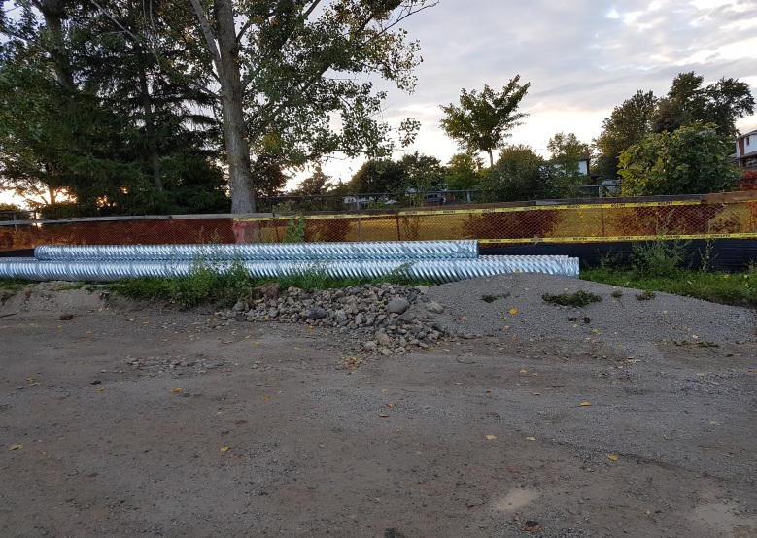
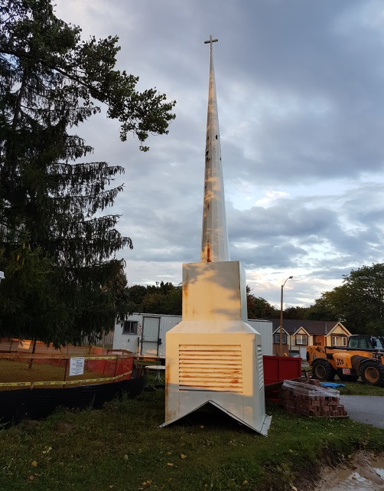
Progress Report Week 13
Corrugated galvanized steel culverts delivered to site
Church steeple removed for re-finishing

Slide 5
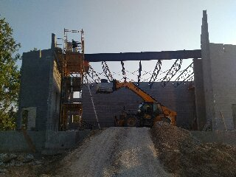
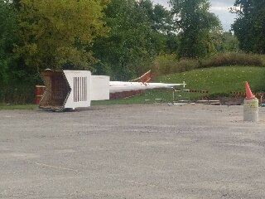
Progress Report Week 14
Masonry progressing on West side of future Platform
Steeple is moved and ready for re-finishing

Slide 6
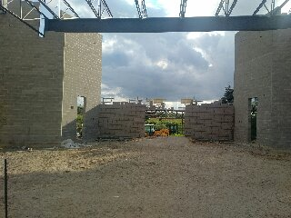
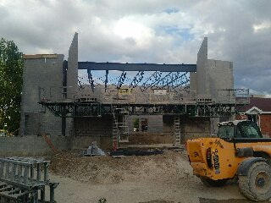
Progress Report Week 14
Masonry progressing on South wall of future Platform

Slide 7
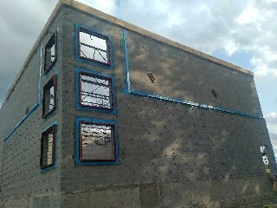
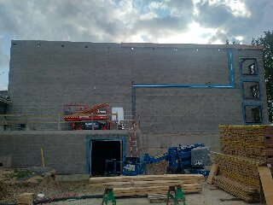
Progress Report Week 14
Water penetration barrier and flashing placed between stucco and brick transition on West and North wall of gym/future sanctuary

Slide 8
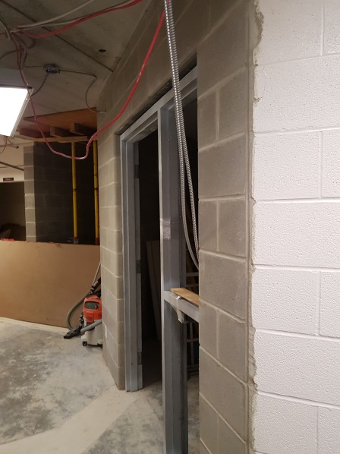
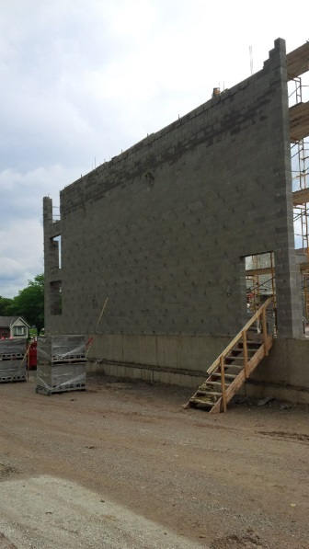
Progress Report Week 15
Masonry and new door frame with sidelight in place at existing basement resource room and corridor
Masonry progress on west wall of gym and future sanctuary

Slide 9
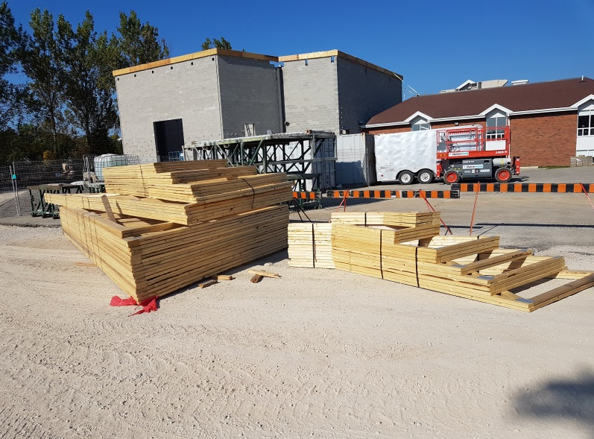
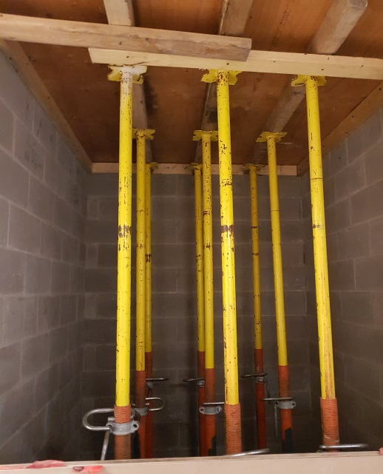
Progress Report Week 15
Wood roof trusses delivered to site
Shoring in place for existing main floor pre-cast slabs to prepare for cutting of opening for elevator shaft

Slide 10
Progress Report Week 15
Wood roof trusses delivered to site
Shoring in place for existing main floor pre-cast slabs to prepare for cutting of opening for elevator shaft

Slide 11
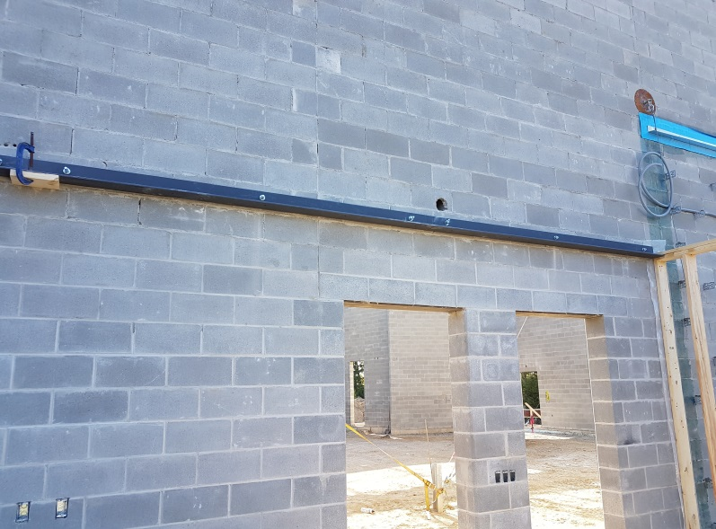
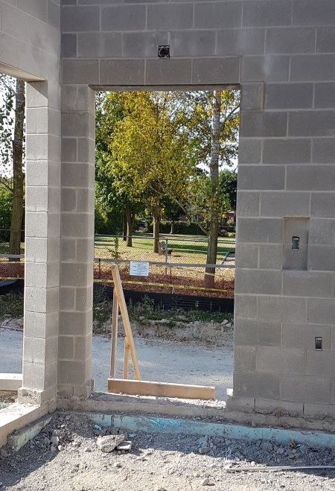
Progress Report Week 15
Steel angle installed to support wood roof trusses over boardroom and office area (future kitchen)
Height of exit door at west side of gym (future sanctuary) corrected

Slide 12
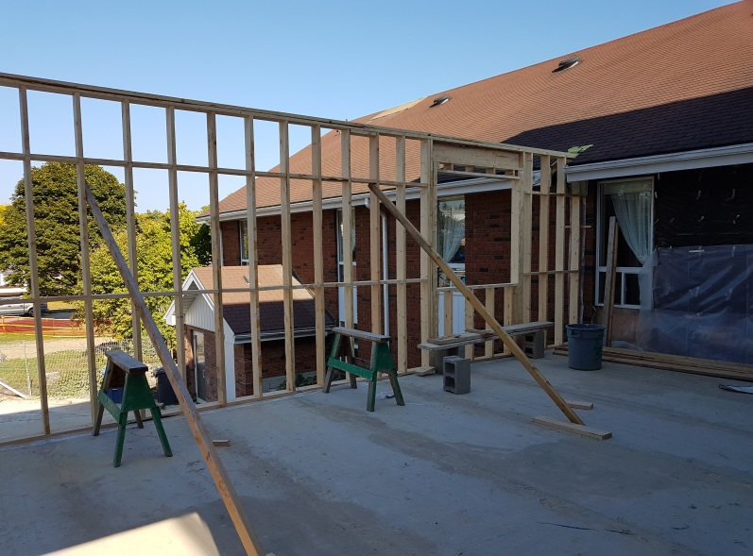
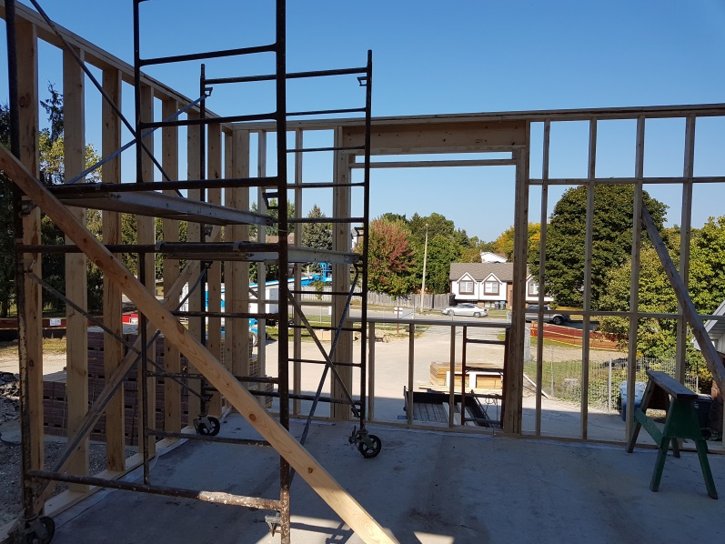
Progress Report Week 15
Exterior wood walls of office area (future kitchen) framed
Exterior wood walls of boardroom (future kitchen) framed

Slide 13
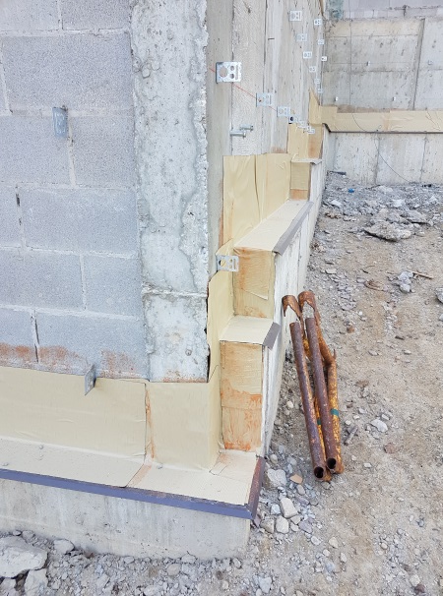
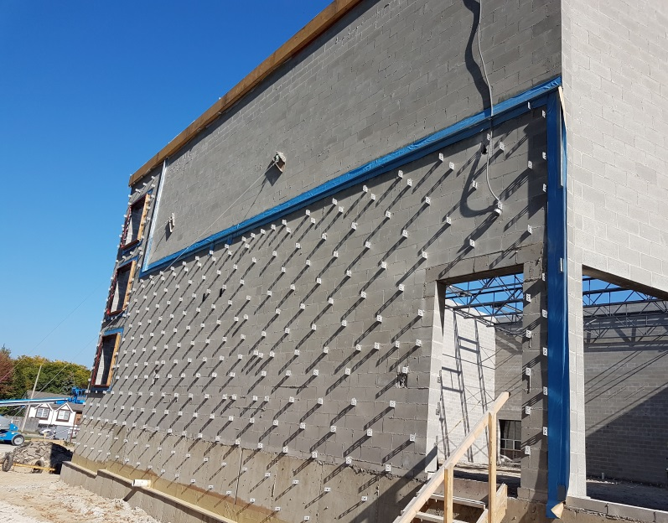
Progress Report Week 15
Self-adhering rubber membrane installed over metal flashing at top of foundation for masonry cavity drainage
West wall of gym with flashings and membranes in place at future transitions between stucco and brick, brick and top of foundation wall and between brick and window and door openings

Slide 14
Progress Report Week 15
Self-adhering rubber membrane installed over metal flashing at top of foundation for masonry cavity drainage
West wall of gym with flashings and membranes in place at future transitions between stucco and brick, brick and top of foundation wall and between brick and window and door openings

Slide 15

Coffee and Muffins provided by Volunteers on Friday mornings
In a effort led by MartineMcQuade, PGCC volunteers are providing coffee and muffins to show our appreciation to those workers who are completing the addition and the renovation to our building.
Thanks to you all!!!

Slide 16
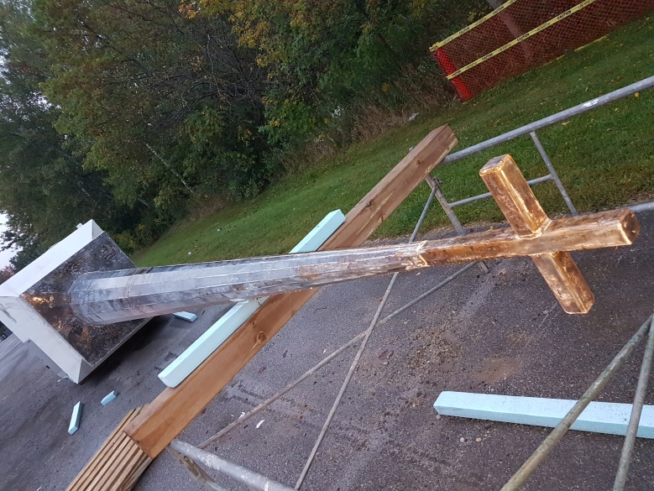
Work completed during Week 15 by Volunteers
Church steeple being ground down in preparation for new finish in a volunteer initiative led by Bernie Kraemer – Thanks Bernie and any who are assisting him with this effort!!!
This volunteer work is expected to save between five and ten thousand dollars!!!!

Slide 17
Other items from Week 13, 14 and15
Construction Progress Meeting # 6 on Thursday, September 14th, 2017 (Note: Adrian on vacation)
Some items discussed and addressed in the past three weeks;
  Steeple was not grounded - price requested to consider grounding
  Electrical and mechanical notice of changes for proposed HVAC changes for boardroom and office area (future kitchen) approved
  Electrical changes proposed for exhaust fan controlled by carbon monoxide detector in tractor storage room approved
  Design provided and approved for new canopy over existing South exit door
  Discussion and request for proposal from Great Lakes Door and Hardware for building access control (two levels of security for rooms via: keying and fob readers on main exterior doors)
  Discussion and agreement on revisions to concrete walk to existing South exit door

Slide 18
Next
Completion of steel roof deck and finishing of bracing for steel roof assembly
Steel and welding inspections
Installation of hollow metal door frames
Beginning spray-in-place foam insulation on concrete block walls
Cutting through existing precast floor for elevator shaft and extend masonry walls for elevator on 1st floor lobby
Volunteers prime and paint steeple lead by Bernie Kraemer

