Slide 1
Construction Update Weeks 16, 17 and 18
September 25^{h} to 29th, 2017
October 2nd to 6th, 2017
October 9th to 14th , 2017

Slide 2
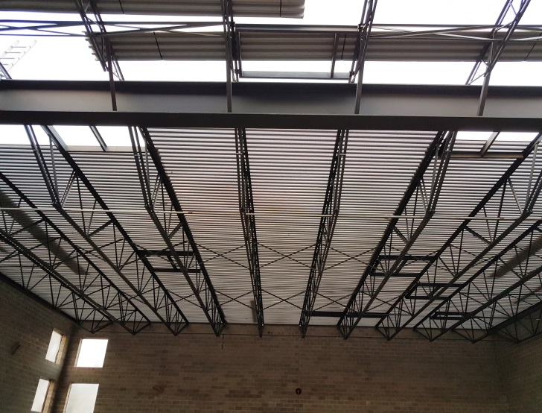
Progress Report Week 16
Wall and gable end framing over boardroom/future kitchen
Steel roof trusses, steel beam and metal roof deck in progress over gym future sanctuary. Perforated roof deck being used to improve acoustical absorption.

Slide 3
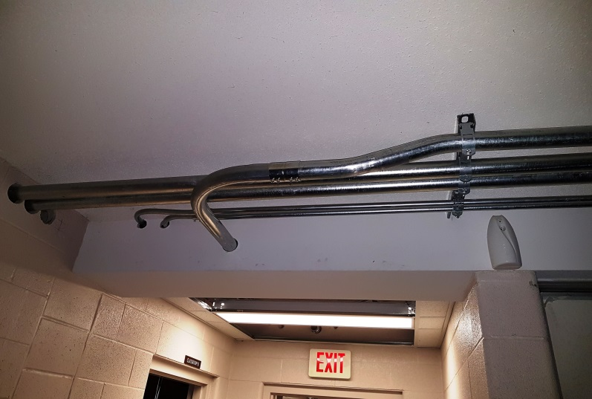
Progress Report Week 16
First floor reinforced concrete block walls in progress for barrier free lift
Main electrical and audio visual conduit feeds to addition over existing fellowship hall

Slide 4
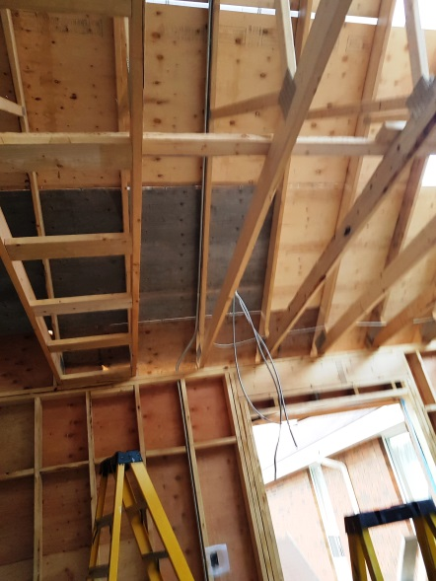
Progress Report Week 17
Wood roof trusses installed and plywood roof sheathing being installed over boardroom and office area (future kitchen)
Electrical wiring and conduit (for AVL) being installed in boardroom and office with rough ins for use as future kitchen

Slide 5
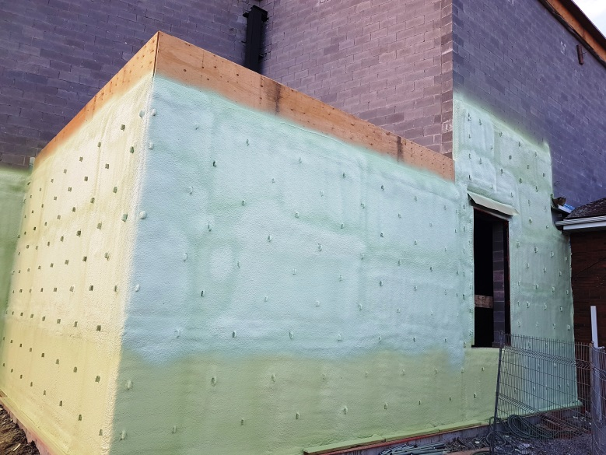
Progress Report Week 17
75mm of continuous spray-in-place foam insulation (R22 C.I.) in place behind future brickwork and brickwork ready for placement
50mm of continuous spray-in-place foam insulation (R13 C.I.) applied and brick ready for placement on storage room plywood wall sheathing. Note, an additional R20 rock wool insulation will be installed in 2X6 stud walls.

Slide 6
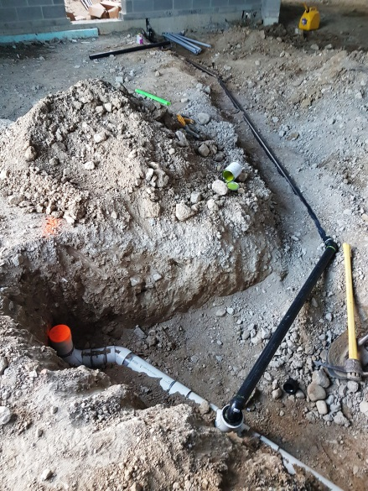
Progress Report Week 17
Underground drainage piping and cleanout installed for future baptistry.jpg
Baptistry drainage piping installed below future concrete slab at rear of future platform area complete venting piping for

Slide 7
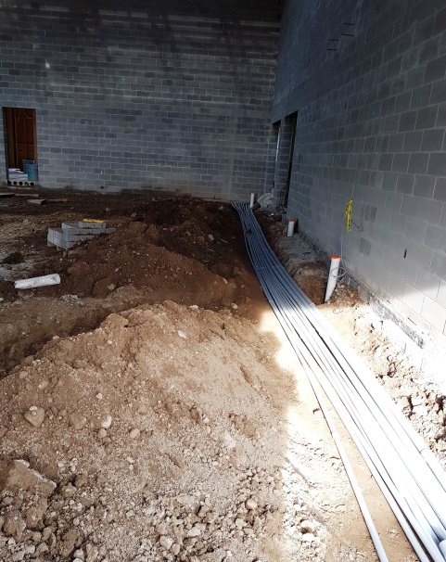
Progress Report Week 18
Our very own, Ben Biffis working on wood roof framing (Framing Futures)
Electrical conduit and plumbing being installed below future gym/sanctuary slab

Slide 8
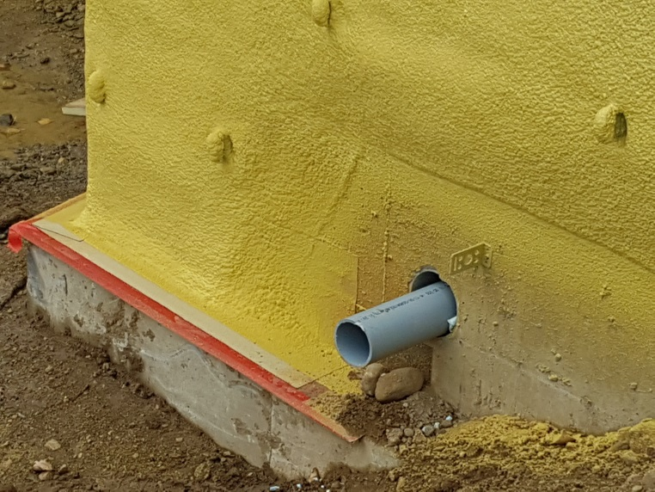
Progress Report Week 18
½” Densglass gypsum, R31 rigid insulation and white TPO (Thermoplastic Polyolefin) roofing being installed and inspected on flat roof
Under slab roof drainage piping extending through exterior wall

Slide 9
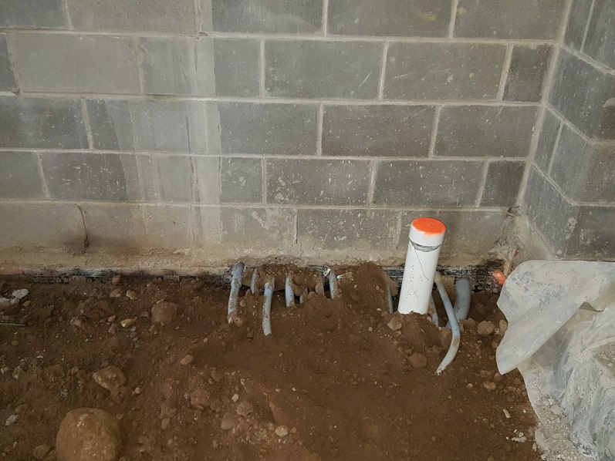
Progress Report Week 18
Brickwork started this week - two days and a lot accomplished
Underground electrical conduit and plumbing backfilled Underground electrical conduit and plumbing backfilled

Slide 10
Volunteer Feature
The freshen up of 1st floor existing building has begun (Week 18) – Thanks to our volunteers!!!
A special thank you to Jonathan Molyneaux and Cora Millar for their organization of this work!!
The master at work - Jonathan Molyneaux cutting in

Slide 11
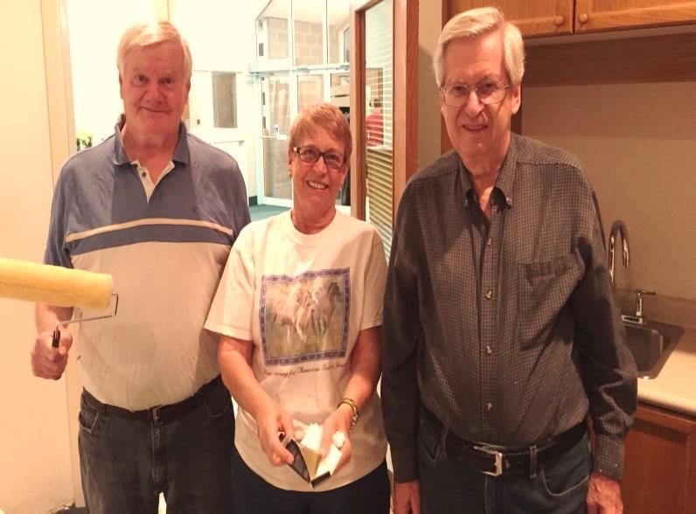
Volunteer Work
Adrian van Eck - filling and sanding walls in existing Sanctuary
The master painters – Joe, Sandy and Ron painting in the administration office

Slide 12
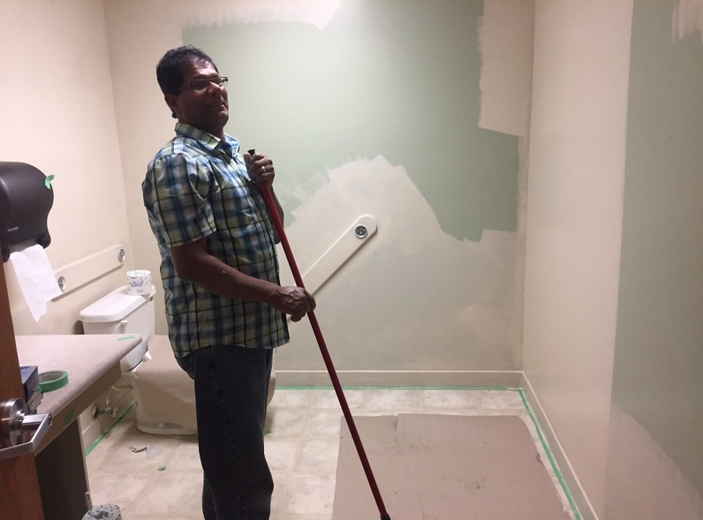
Volunteer Work
Painting masters -Jonathan Hui and Jonathan Molyneaux
Tucker Beharry - rocking and rolling on existing barrier free washroom walls

Slide 13
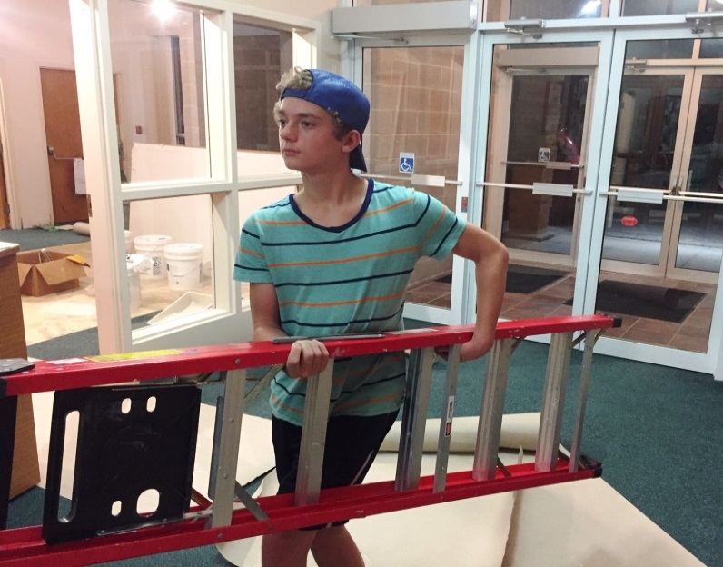
Volunteer Work
The A Team - Ethan van Eck, Rose van Eck and Alysha Dykstra helping out with preparation and painting of 1st floor rooms.
Ethan van Eck – even carrying a ladder you can look cool and collected

Slide 14
Other items from Week 16, 17 and18
Construction Progress Meetings #7 held September 28, 2017 and #8 held on October 4, 2017
Building Committee Meeting #15 held on October 5, 2017
Some items discussed and addressed in the past three weeks;
Dedication stone selected and purchased and on display in lobby
Security cameras and wiring approved at main entrances
Wall painting scheme and carpet colours approved
Desks selected for office area
Carpet quote for existing first floor rooms approved (sanctuary and pastors office will not be re-carpeted)
Door hardware quote for new and re-keying of existing approved (fob access controls declined due to 14K price tag, conduit will be roughed in for future)
New rear canopy design approved
Steeple grounding declined

Slide 15
Next
Continue installation of brickwork
Complete installation of wood roof trusses and roof sheathing over storage rooms beside future platform
Complete installation of roof insulation and TPO roof membrane and 3rd party inspections of same
Set roof top HVAC units and begin installation of ductwork
Volunteers will continue with painting of existing 1st floor rooms

