Slide 1
Construction Update Week 20 & 21
October 23rd to November 4th, 2017

Slide 2
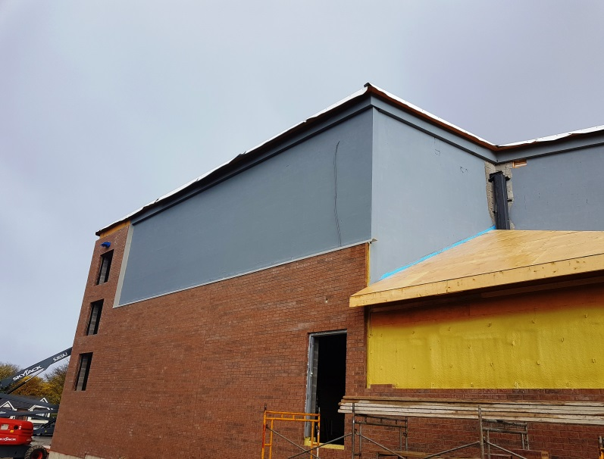
Progress Report Week 20
Installation of metal transition flashing over Blueskin rubber transition membrane
Brick nearing completion on West wall of gym /future sanctuary and storage room 113. Water penetration barrier installed over upper portion of block walls in preparation for installation of 127mm insulation.

Slide 3
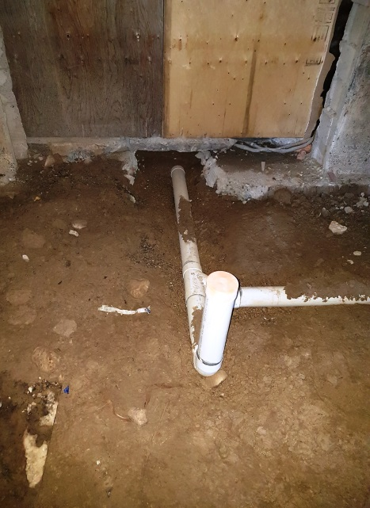
Progress Report Week 20
Thinking ahead! - framed openings for future make up air unit, exhaust fans and grease hood duct (fully complete above roof line complete with insulated curbs, temporarily insulated and capped with metal deck screwed on from bottom).
Installation of underground sanitary piping below storage room under future kitchen, capped below double doors to storage room

Slide 4
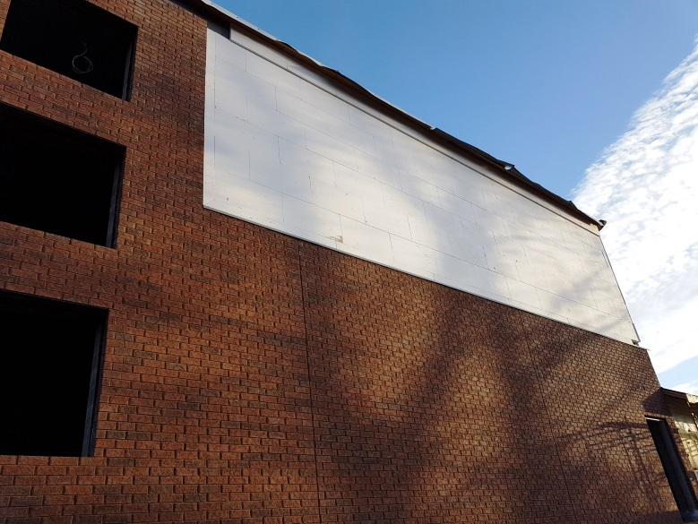
Progress Report Week 20
A very busy construction area!
Installation of 127mm foam insulation at top of west wall of future sanctuary. Installation of vertical application of adhesive on backside provides space for moisture to discharge out of vertical secondary drainage plane to top of transition flashing.

Slide 5
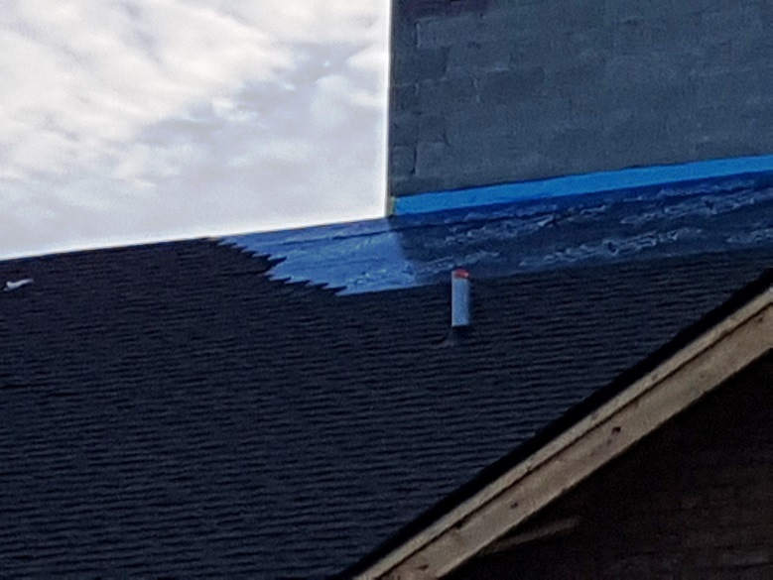
Progress Report Week 20
Brick and louvre installation complete at North wall of addition
Installation of shingles over self-adhering rubber membrane with rubber flashing at roof/concrete block wall transition. Also note plumbing vent terminal with orange test cap in place to prevent water entry until future commerical kitchen plumbing in completed

Slide 6
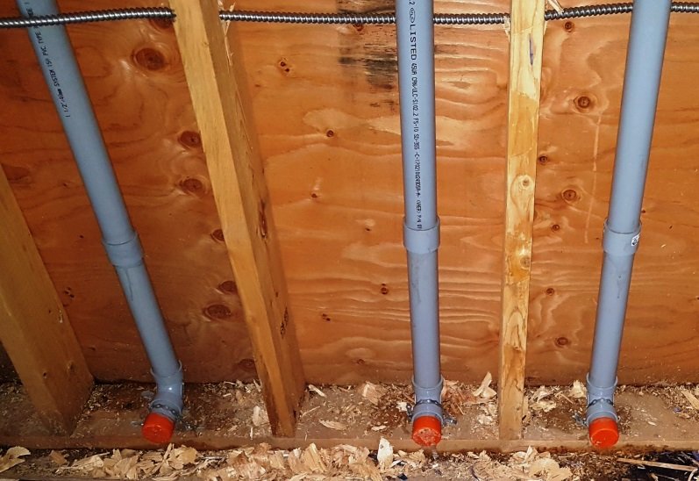
Progress Report Week 20
Support of short trusses over storage rooms at concrete block wall
Plumbing vents roughed in for future commerical kitchen to behind future baseboard

Slide 7
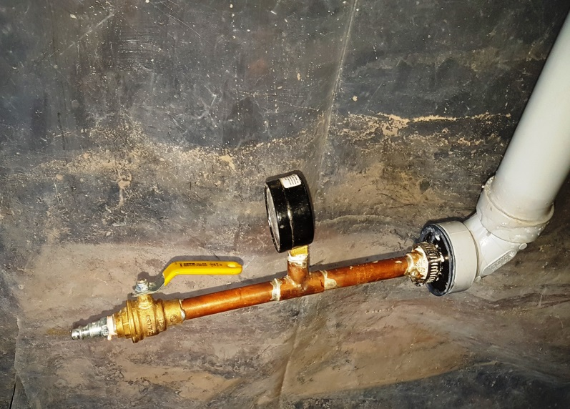
Progress Report Week 20
Test plug in place in attic plumbing vent in line cleanout installed adjacent to attic access to make future testing of drains, waste piping easy
Plumbing vent piping under pressure test

Slide 8
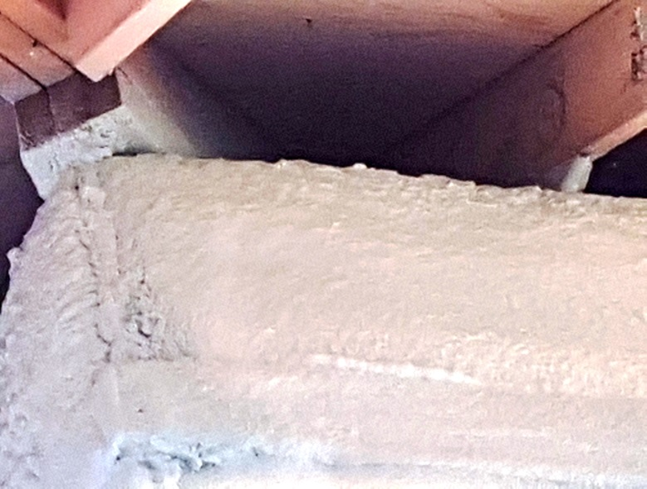
Progress Report Week 20
Water penetration barrier complete over block wall, note also roof overflow with roof membrane extended through same
50mm spray in place foam insulation over plywood sheathing above soffit of storage room walls

Slide 9
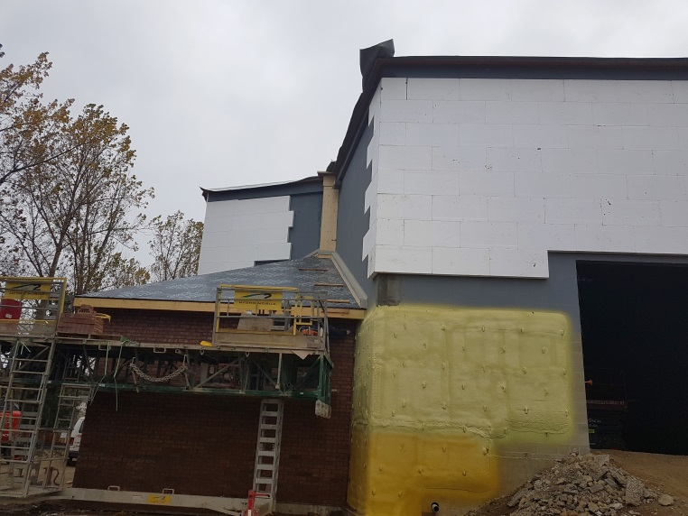
Progress Report Week 21
Work exterior wall water penetration barrier and insulation up to temporary opening in South wall of future platform
Masons completing final joint racking at Southwest corner, storage room 113

Slide 10
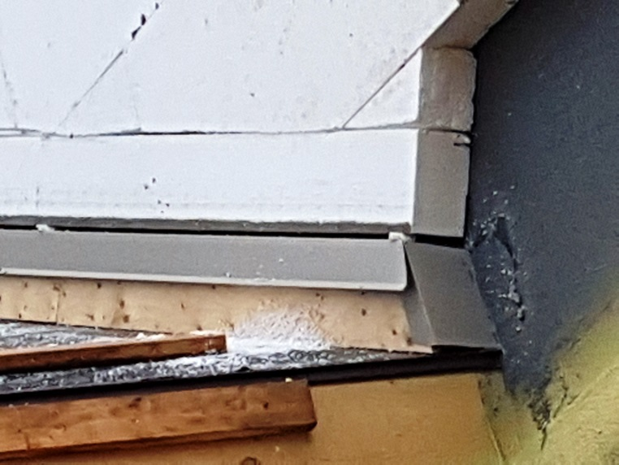
Progress Report Week 21
127mm insulation in place with vertical drainage behind and water penetration barrier applied to concrete block wall. Also note, metal flashing over insulated wood curb and rubber membrane on lower roof.
127mm thick insulation in place ready for application of stucco finish, back-wrapped above metal flashing complete with gap for drainage

Slide 11
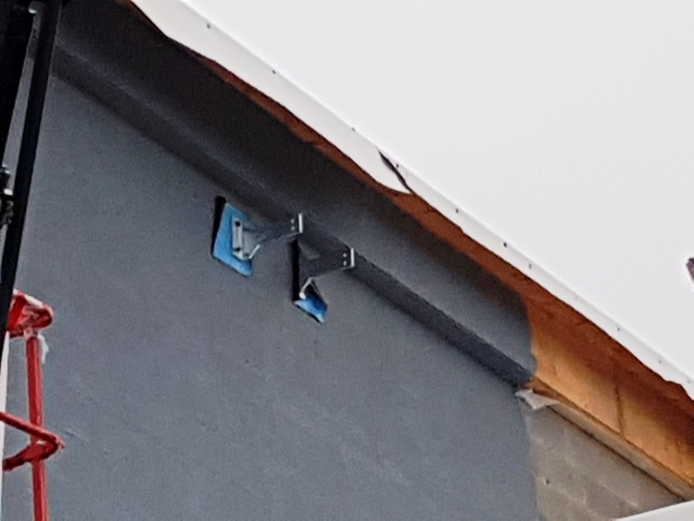
Progress Report Week 21
127mm insulation in place with vertical drainage behind and water penetration barrier applied to concrete block wall. Also note, metal flashing over insulated wood curb and rubber membrane on lower roof.
Brackets to support hot galvanized ladder to upper roof installed with rubber membrane behind same

Slide 12
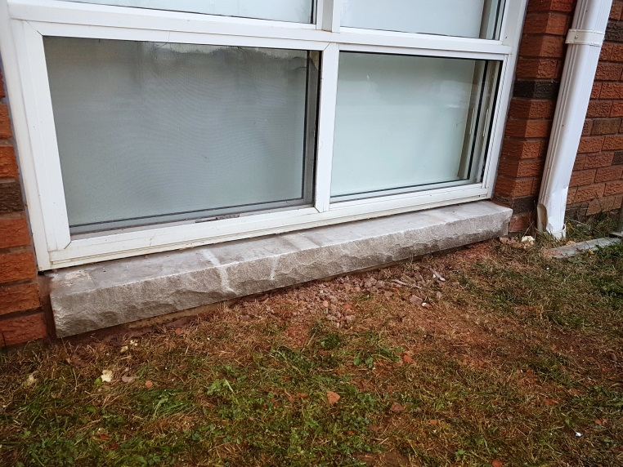
Progress Report Week 21
Concrete block infill replaced with brick over existing rear entrance
Four of existing basement brick sills replaced with solid stone sill with rubberized flashing behind

Slide 13
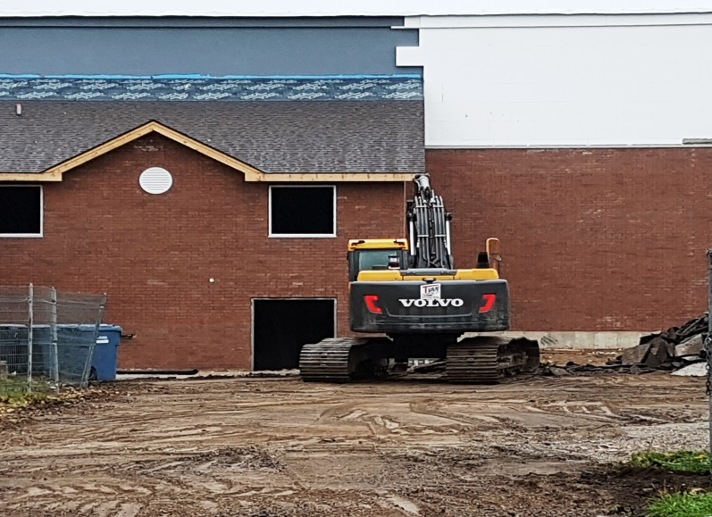
Progress Report Week 21
Parking lot lamp posts ready for installation
Existing paving removed at Northwest basement entry and drive

Slide 14
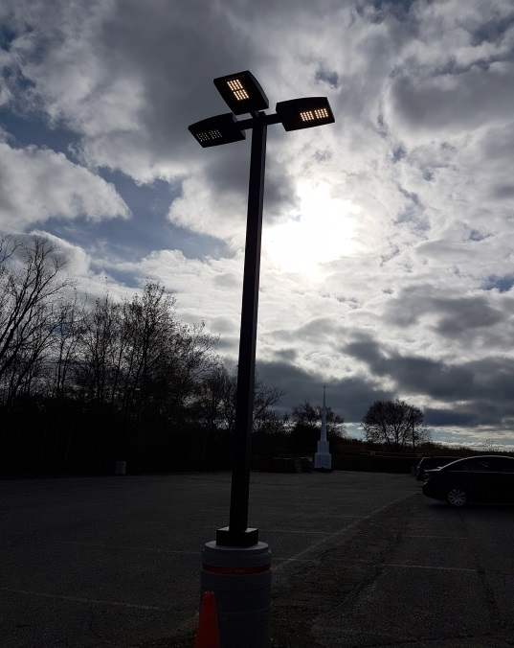
Progress Report Week 21
Parking lot lamp posts ready for installation
Then there was light!!! parking lot lamps installed and working

Slide 15
Volunteer Work
The freshen up of the basement level is well underway(Week 20) – Thanks to our volunteers!!!
A special thank you to Jonathan Molyneaux and Cora Millar for their organization of this work!!
Owen Brook, Ron Traviss, Tim Brook and Elisa Brook painting up a storm in the corridor leading to youth room

Slide 16
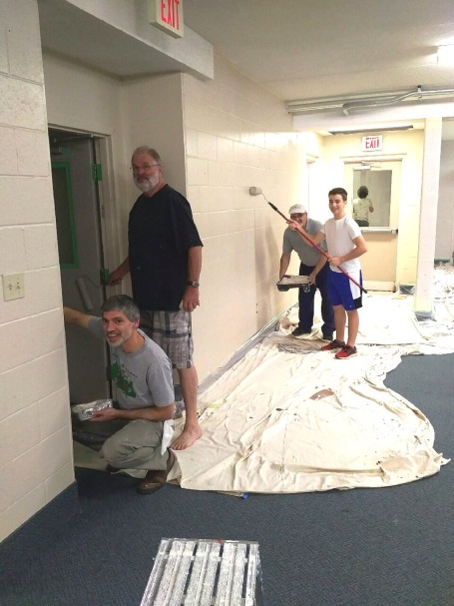
Volunteer Work
The family team !! Stacy, Trent and Steve Favrin painting existing basement corridor
Allan Willms, Tom Millar, Tony Masi and Noah Masi the double tag team painting existing fellowship hall and corridor to washrooms

Slide 17
Volunteer Work
The Irishman hard at work again!!!!! There is no stopping this fighting Irishman!!!! - Peter Carberry reinstalling wall louvre

Slide 18
Other items from Week 20 and 21
Construction Site Meeting #9 held on October 26, 2017. Glenn Rienders, Mark Dykstra, Adrian van Eck, Les McComb and John Donato present.
Some items discussed:
EIFS colour and texture confirmed
Coping flashing colour confirmed
Pricing for spray-in-place foam insulation below gym/future sanctuary floor slab to replace proposed 2” board insulation and perminator radon barrier
Gas meter installation, roof drainage piping, preparation of elevator machine room discussed
Rear canopy design approved
Approved raised concrete patio roof walkways for service of HVAC units

Slide 19
Other items from Week 20 and 21
Some items discussed and addressed in the past two weeks;
Relocation of roof drainage piping in future platform area. Mechanical Engineer has re-designed this and quote for changes has been requested from Wellington.
Updated construction estimate provided by CRD
Concrete slab for lower bike rack to be located beside lampstand adjacent to concrete walk to city sidewalk
Confirmation of main floor colour selections
Gas piping, gas meter installation, reconnection of existing HVAC
Approval of spray-in-place radon mitigation system received

Slide 20
Next
Installation of EIFS (Exterior Insulation Finish System) will continue
Work on concrete walks will commence
Roof top HVAC units will be craned into place and installation of ductwork may begin
Re-installation of steeple
Barrier free lift installation (start of 3 to 4 week process)
Volunteers will continue with painting of existing rooms on the basement level

