Slide 1
Construction Update Week 24 to 26
November 20th to 25th, 2017
November 27th to December 2nd , 2017
December 2nd to 9th, 2017

Slide 2
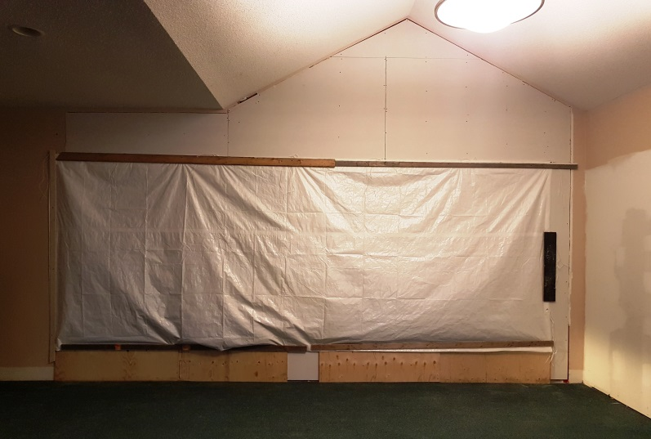
Progress Report Week 24
Cracking through the existing wall into new gym and future sanctuary
Existing window assembly removed, new laminated beam installed and two paired door openings made for access to gym and future sanctuary from existing lobby

Slide 3
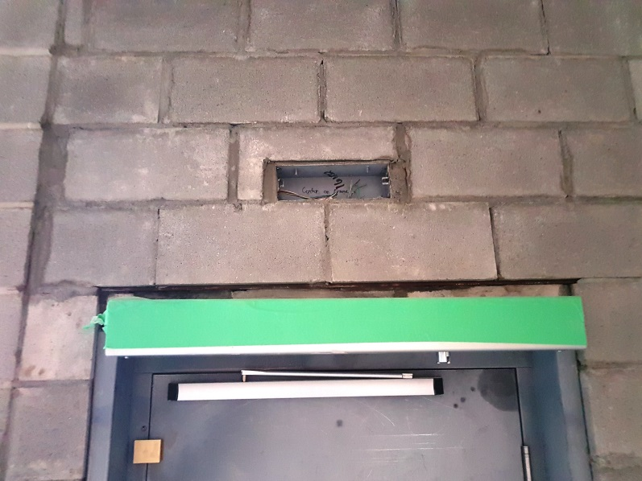
Progress Report Week 24
Mason completing installation of concrete block infill around 1st floor barrier free lift door frame
Masonry complete around barrier free lift door

Slide 4
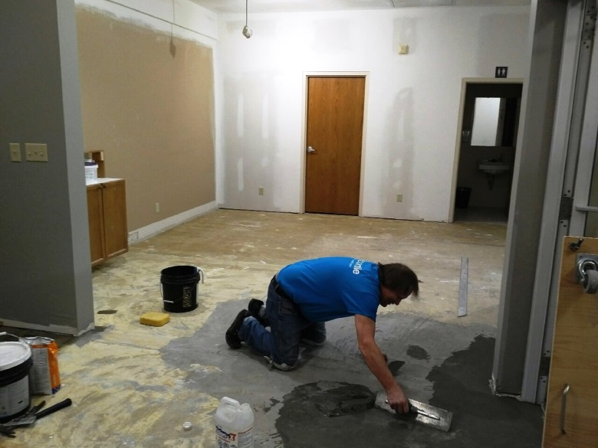
Progress Report Week 24
Elevator lift machine room exhaust fan duct boxed in on 1st floor lobby
Floor installer completing floor levelling before installation of new carpet tile in lobby

Slide 5
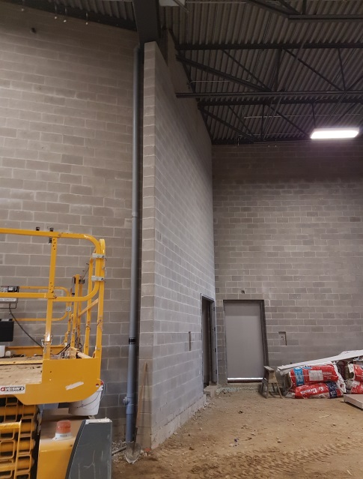
Progress Report Week 25
Carpet tile installation in lobby and administration office progressing
Roof water drainpipe relocated to behind wing wall

Slide 6
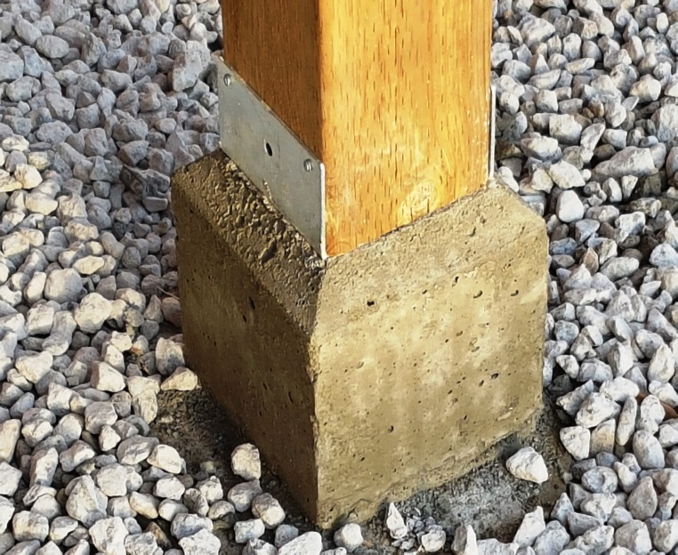
Progress Report Week 25
Rear wood canopy framing completed
Pressure treated 150mm X 150mm wood column completed with tapered concrete base to prevent water accumulation and anchorage to prevent uplift

Slide 7
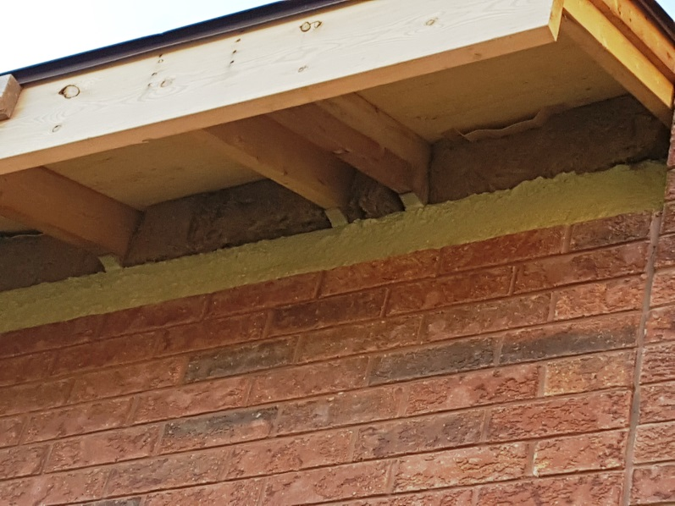
Progress Report Week 25
Rear canopy column with straps to wood beam connection to prevent uplift
Rockwool insulation at top of exterior wood framed walls with vents from soffit to attic spaces for storage rooms and kitchen

Slide 8
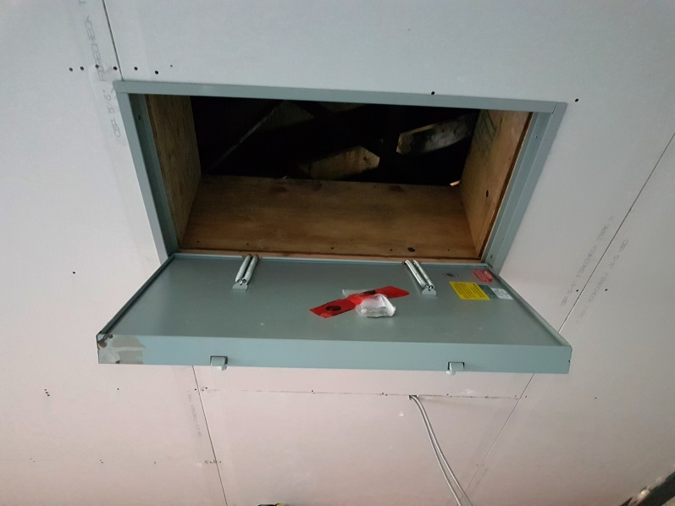
Progress Report Week 25
Fire rated drywall with fire rated attic access doors installed on bottom of all wood truss roofs
Fire rated and insulated attic access hatch

Slide 9
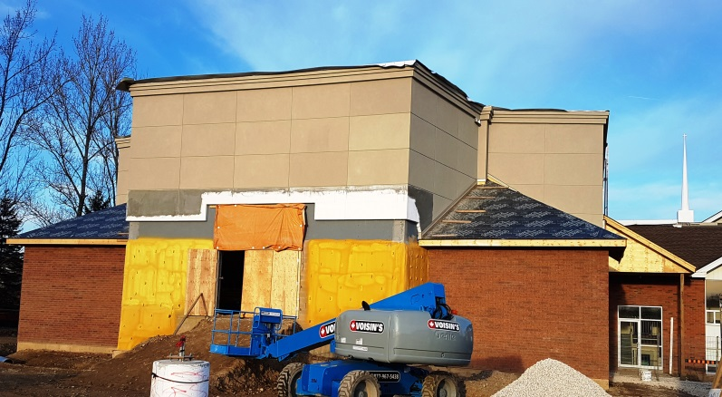
Progress Report Week 25
Due to a break in the weather stucco is complete except at lower rear wall of platform!!

Slide 10
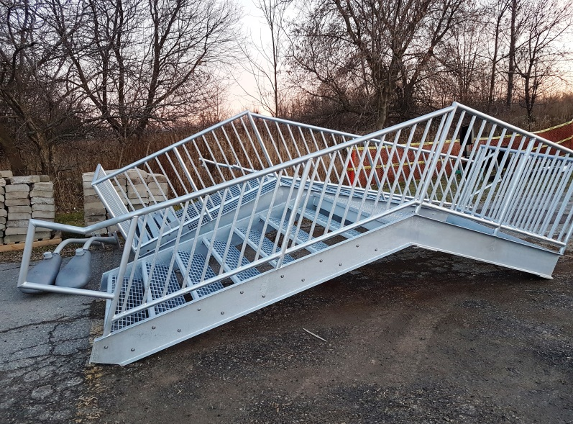
Progress Report Week 25
Fabric over concrete curb to protect from frost and gravel base in place for future concrete walk as well as concrete bike rack pad
Hot galvanized steel landings, emergency exit stairs and landings delivered to site

Slide 11
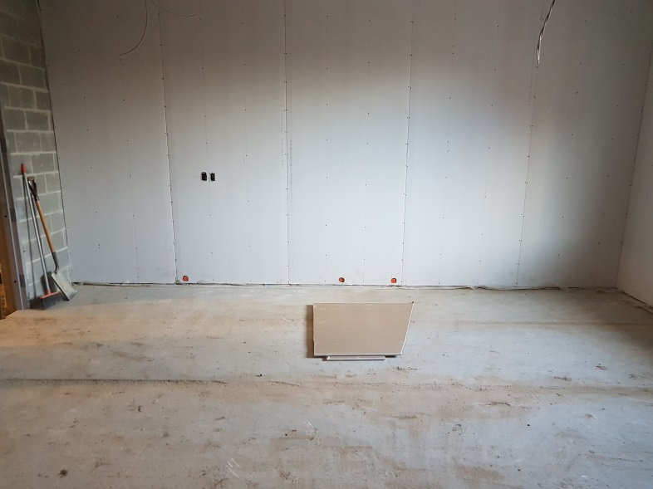
Progress Report Week 25
Drywall on North wall of future kitchen, note four plumbing vents roughed in that will be capped behind carpet base for future connections
Drywall on West wall of future kitchen, note plumbing vents capped at bottom that will be located behind future carpet baseboard

Slide 12
Progress Report Week 25
Drywall on North wall of future kitchen, note four plumbing vents roughed in that will be capped behind carpet base for future connections
Drywall on West wall of future kitchen, note plumbing vents capped at bottom that will be located behind future carpet baseboard

Slide 13
Progress Report Week 25
Drywall on North wall of future kitchen, note four plumbing vents roughed in that will be capped behind carpet base for future connections
Drywall on West wall of future kitchen, note plumbing vents capped at bottom that will be located behind future carpet baseboard

Slide 14
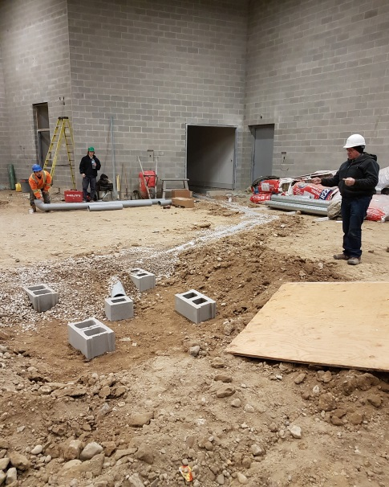
Progress Report Week 26
Aluminum installation completed at rear canopy except for eaves and downspout section
Installation of radon gas mitigation piping and collection pit being installed below future gym and sanctuary slab

Slide 15
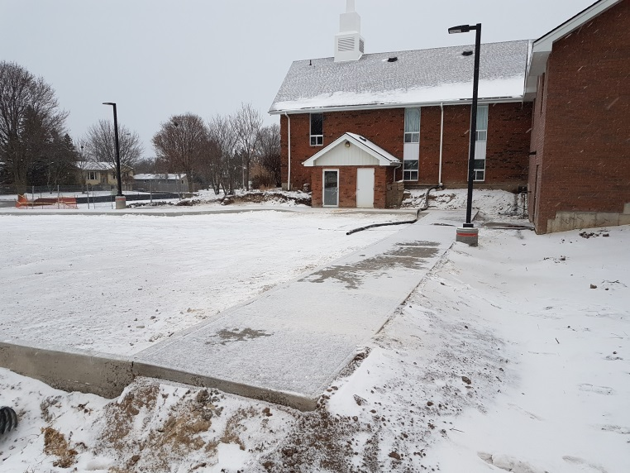
Progress Report Week 26
Concrete pad for bike rack with light standard installed along concrete walk to city sidewalk
Exterior concrete walkways poured and new light standards installed

Slide 16
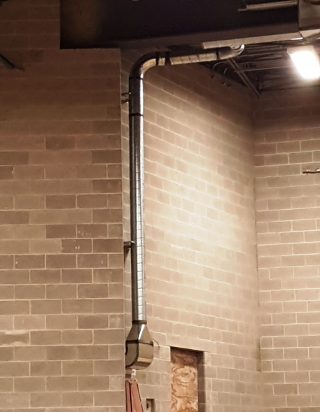
Progress Report Week 26
Ductwork serving future platform area
Ductwork serving storage and electrical room to left of future platform

Slide 17
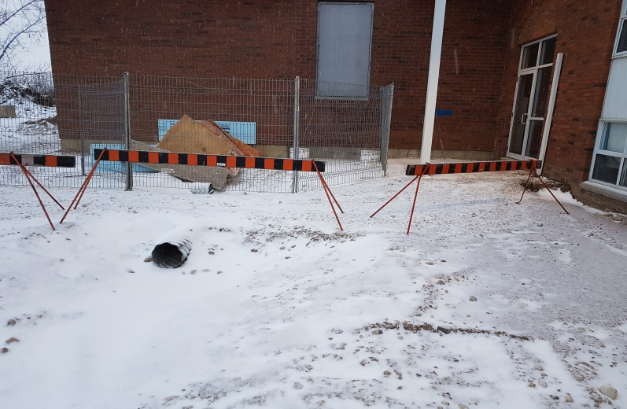
Progress Report Week 26
Poly culvert and grading over same at west side of future sanctuary wall – great solution provided by John Donato of CRD to solve a grading problem!!!
Galvanized culverts and gravel base for future walkways, also note concrete landing poured and covered for new exterior hot galvanized exterior emergency exit stair

Slide 18
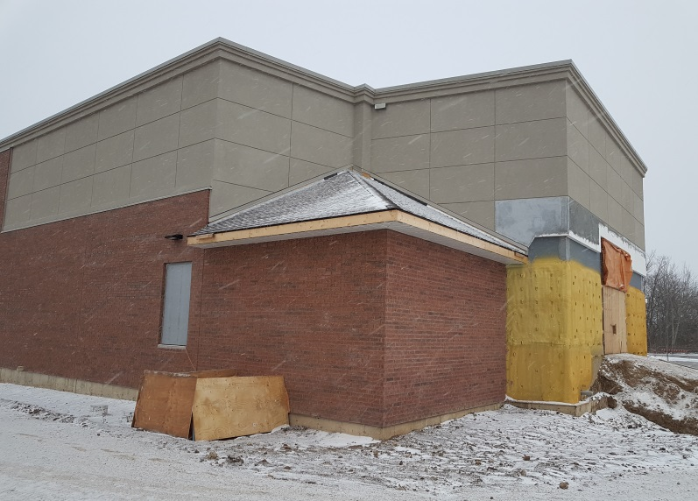
Progress Report Week 26
Asphalt shingling completed and aluminum fascia and soffit progressing well
Concrete landing poured and enclosed and heated for curing, exterior emergency exit stair light installed, asphalt shingles complete on sloped roofs

Slide 19
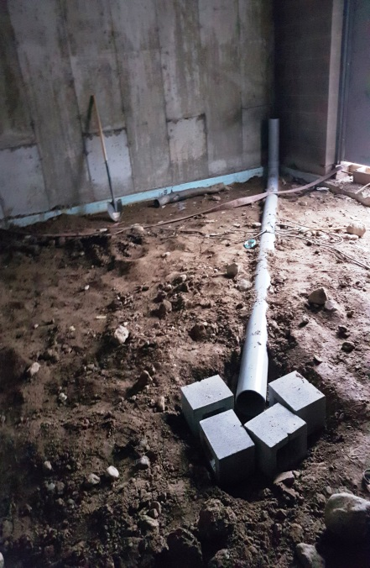
Progress Report Week 26
Metal coping completed on top of gym/future sanctuary parapet
Radon piping and collection pipe rough in below future floor slabs serving basement storage rooms

Slide 20
Volunteer Work
The freshen up of the basement level and first floor progressing very well! (Week 24 and 26) – Many thanks to our volunteers!!!
A special thank you to Mark Dykstra, Jonathan Molyneaux and Cora Millar for their organization of this work!!

Slide 21
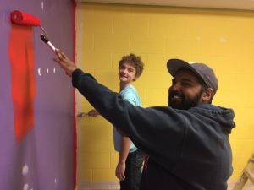
Volunteer Work
Alysha Dykstra and Naomi McMurdo painting Matador Red feature wall in the youth room
Cheyenne Geense and Ethan van Eck painting youth room wall

Slide 22
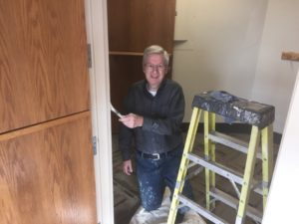
Volunteer Work
Tucker Beharry painting the existing washrooms
Ron Traviss painting door frames – this man has been a huge contributor to the painting effort!

Slide 23
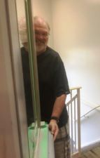
Volunteer Work
Mark Dykstra painting existing lobby
Tom Millar painting doors

Slide 24
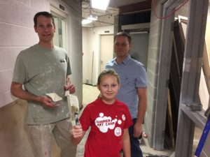
Volunteer Work
Adrian van Eck paint existing rear stair wall, Tom Millar painting doors
Mark Dykstra, Rose and Adrian van Eck painting it up

Slide 25
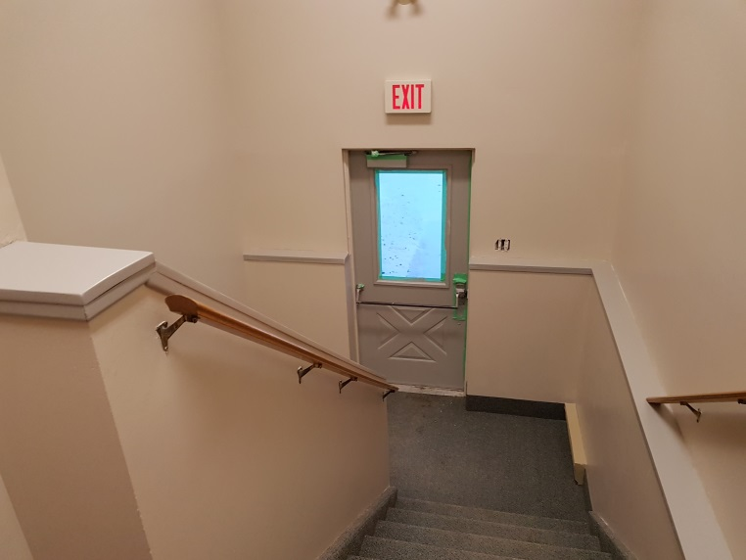
Volunteer Work
Library painting completed by Adrian van Eck with some help from Bernie Kraemer
Existing stair from sanctuary to basement painted

Slide 26
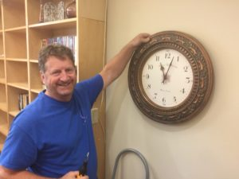
Volunteer Work
Rosalie Gascho and Cora Millar reload books on shelves in library
Bernie reinstalling clock in the library after painting and flooring are complete

Slide 27
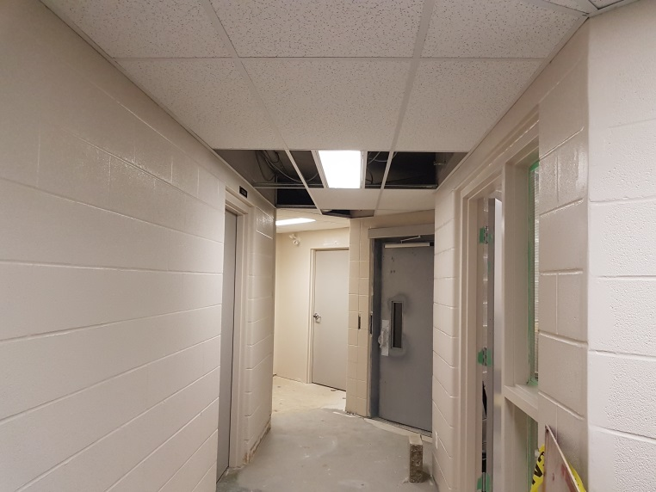
Volunteer Work
Alan Willms paints new block wall in hall outside resource room and Ron Traviss is painting elevator machine room
Hall to resource room painted – looking great!

Slide 28
Other items from Week 24 to 26
Construction Site Meeting #11 held on November 23, 2017 at 7:00am
Mark Dykstra, Adrian van Eck, John Donato, Les McComb, Matt Reid (Wellington) present
Revised ductwork layout for area above future stage reviewed and approved
Revised rainwater drainage approved
John Donato’s proposal to minimize excavation extra for revision to grading approved
Asphalt paving will not be completed this year (plant closed)
Construction Site Meeting #12 held on December 7, 2017 at 7:00am
Mark Dykstra, Adrian van Eck, Les McComb, John Donato, Steve Bock, and Kevin (Juno) and George(from Wellington) present.
Control of lighting in gym/future sanctuary discussed among other items
Lighting immediately outside of elevator on both floors will be wired as Night Lights.
Listing of items to be completed in spring
Building Committee Meeting #17 held on December 5th, 2017 at 7:30pm
Update on upcoming tasks, schedule, occupancy time, keying, security cameras, elevator signage, elevator keying, painting, coat racks, repair item punch list, retaining walls and landscaping in spring, volleyball nets, retaining wall, landscaping, and budget.

Slide 29
Next
Installation of spray-in-place foam insulation below gym/future sanctuary floor slab as well as heavy poly barrier below future platform and storage room floor slabs
Pouring of concrete floor slab in gym/future sanctuary
Installation of hot galvanized steel emergency exit stairs at exterior exit doors from gym/future sanctuary
Re-keying of all existing doors
December 22-January 2, 2018 Christmas Holiday Break

