Slide 1
Construction Update Week 31 to 32
January 15th to 20th, 2018
January 22nd to 26th, 2018

Slide 2
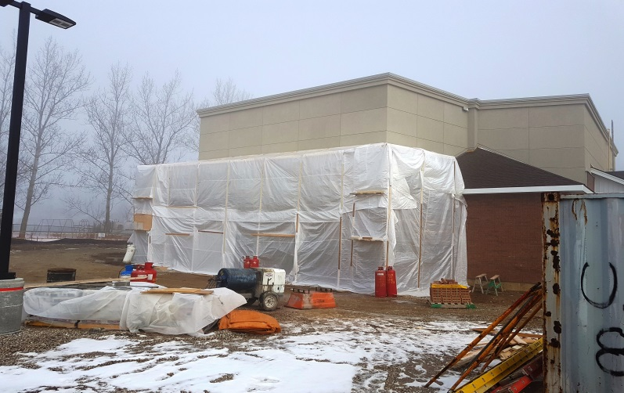
Progress Report Week 31
Scaffolding installed to enable foam insulation, brick veneer and stucco to be completed at rear wall of platform
Tarp enclosure to provide propane heating for completing of brick and stucco at rear wall of platform

Slide 3
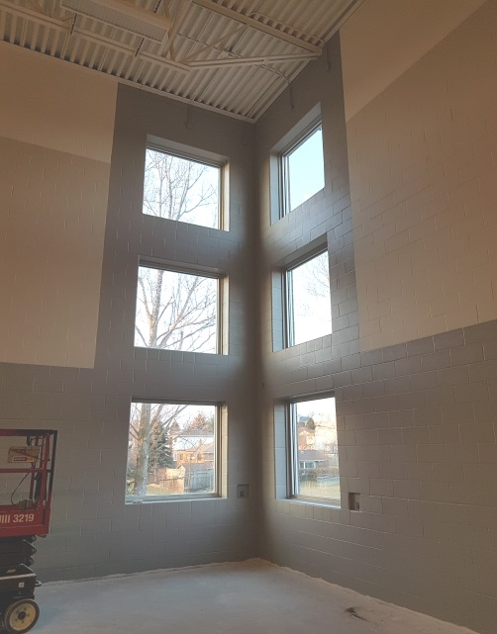
Progress Report Week 32
Painting of walls and ceiling completed at future platform area
Wall painting and trim completed around window at corner of gym and future sanctuary

Slide 4
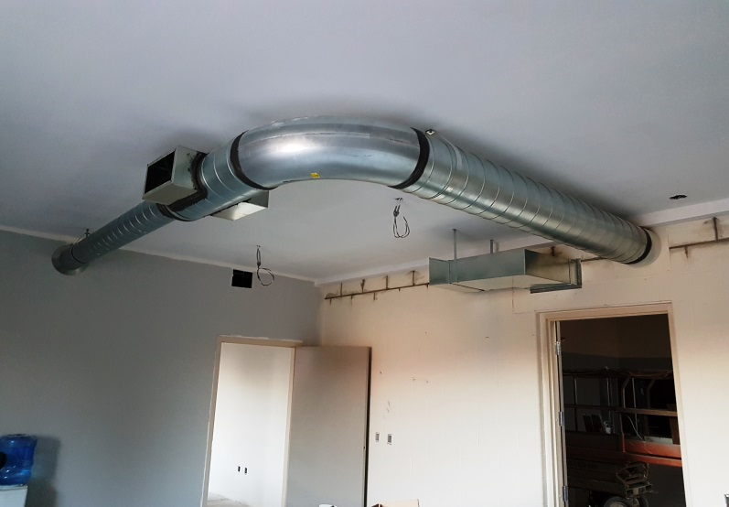
Progress Report Week 32
Basketball backboard and nets installed installation with mechanism to permit them to swing back against the wall when used as sanctuary
Ductwork installed in boardroom/future commercial kitchen, painting on walls completed except for concrete block wall

Slide 5
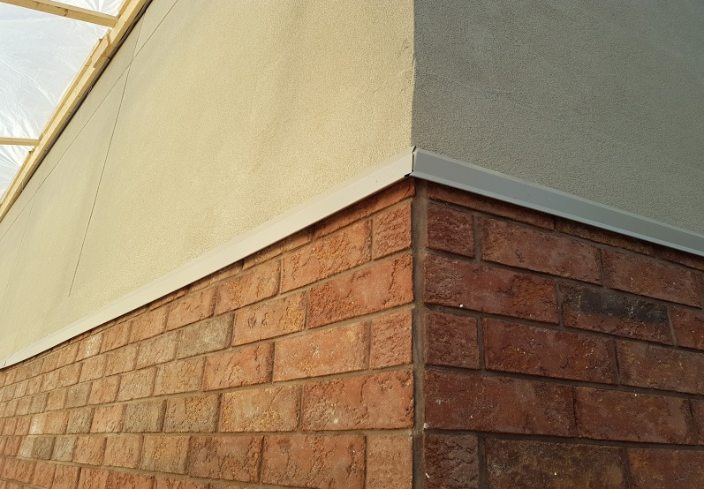
Progress Report Week 32
Basketball backboard and nets installed installation with mechanism to permit them to swing back against the wall when used as sanctuary
Brick veneer and stucco with transition flashing complete at rear wall of building addition

Slide 6
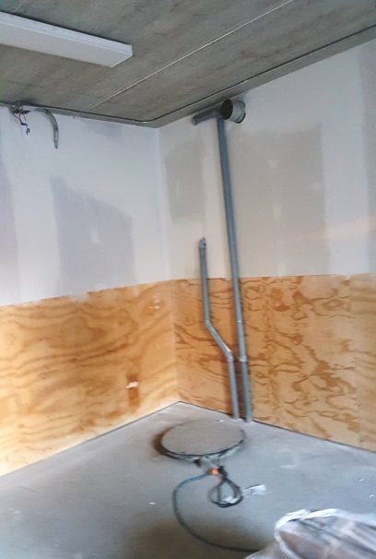
Progress Report Week 32
Walls painted in storage room to right of future platform. lower hardboard painted grey and drywall above a lighter grey
5/8” good one side plywood and drywall above completed in lawn tractor storage room below boardroom/future kitchen

Slide 7
Volunteer Work
The freshen up of the basement level and first floor progressing very well!!
Week 31 and 32
Many thanks to our volunteers!!!
A special thank you to Mark Dykstra, Jonathan Molyneaux and Cora Millar for their organization of this work!!

Slide 8
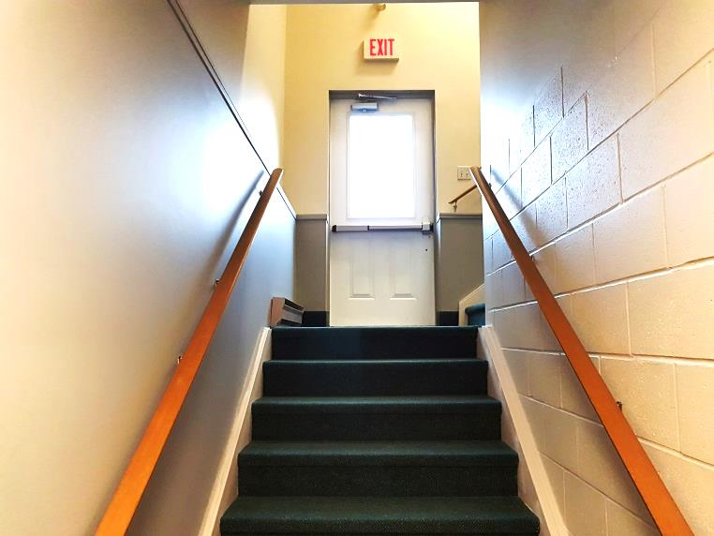
Volunteer Work
Painting of Existing Stair 2 from Existing Sanctuary to basement Fellowship Room almost complete

Slide 9
Other items from Week 31 to 32
Construction Site Meeting #15 held on January 18th, 2017 at 7:00am
Mark Dykstra, Glenn Reinders, John Donato, Les McComb, Matt Reid, Les McComb
Adrian not present due illness
Wellington to provide pricing for heat tracing cable for u/g roof drain discharge on both 4” and 6” pipe as discussed in site meeting (Heat trace cable on 4” to run to cleanout at stage area, Heat trace cable on 6” pipe to run full length from new discharge end to existing roof drain on exiting building mechanical well)
All RTU’s to be fired up prior to next site meeting on Feb. 1st for engineers review
Test certificates for emergency lighting & fire alarm for next site meeting date
Additional requested base board heaters for lower level to be installed.
Receptacle in Storage Room 025 to be relocated to Room 022.
Receptacles in Storage Room 022 to be mounted at counter height – see Les McComb.
Submit Close Out Documentation to be submitted to CRD by trades – 3 hard copies required.

Slide 10
Next
Installation of new child-proof electric baseboard heaters and thermostats in two of existing basement rooms (under maintenance budget but completed by June Electric)
Painting of doors and frames and installation of balance hardware
Installation of vinyl composite tile flooring
Installation of electrical switches and devices
Fire alarm verification
Installation of ventilation fan and ductwork in basement storage room linked to carbon monoxide detector
Lower level carpet flooring – Stair 132, Workroom 006, corridor
Complete balance of aluminum siding, soffits, fascia

Slide 11
Items to be completed in the spring (April/May 2018)
CRD Construction
Exterior painting of insulated metal doors and metal frames
Exterior grading and granular bases
Concrete sidewalks on South side of existing building
Asphalt paving
PGCC Volunteers
Construction of retaining walls at sides of basement entrance
Painting of exterior door frames and doors
Cleaning of all windows, doors and glazing assemblies

